Slide 1

Design
sdmay22-42
Team: Jason Grunklee, Freedom Clark, Animesh Shrouti, Chimzim Ogbondah, Tzu-Chien Liu, and Robert Wedan

Slide 2
Design Context
Public health, safety, and welfare
Global, cultural, and social
Environmental
Economic

Slide 3
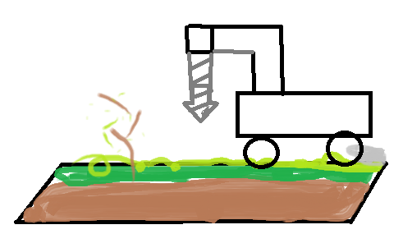
User Needs
User needs statement
Client needs statement

Slide 4
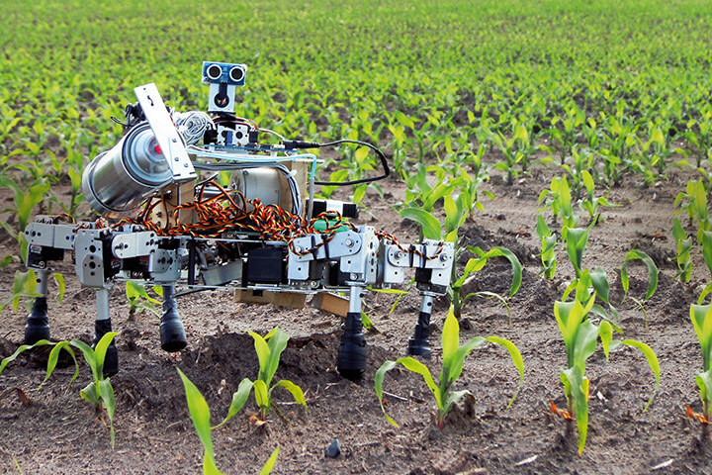
Prior Work/Solutions
Systems like ours currently exist in the agricultural field
Advantages of our system
Disadvantages of our system

Slide 5
Technical Complexity
Complexity through subsections and need for component cohesiveness
Complexity through challenging industry standards

Slide 6
Design Decisions
Selecting the right commercially available robot
Selecting the right commercially available NDIR sensor
Choosing what drilling mechanism will we use to push the sensor into the ground
Deciding how will we attach the sensor to the drilling mechanism
How will we attach the drilling mechanism to the robot
How do we account for the torque of the drill
How will we send data from the robot to the user
How will we design the user interface to be accessible by the user

Slide 7
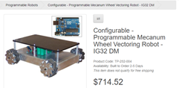
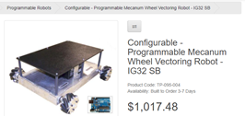
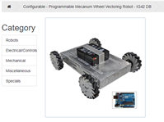
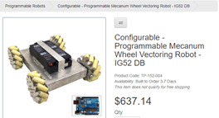
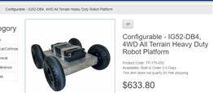
Ideation
Considerations for selecting the perfect robot
Price, programmability, dimensions, weight, payload, speed, and battery life of the robot

Slide 8
Decision-Making and Trade-Offs
Understanding trade offs between competing robots
Making decisions in the best interest of the whole system

Slide 9
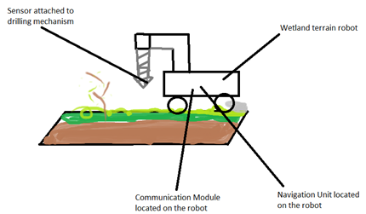
Design Visual and Description
Our current design will look something like this. A land roaming vehicle with a drilling mechanism that has a sensor attached to receive data. It will move from point to point using a navigation unit that will use GPS. The data collected from the robot will then be sent to the user using the established communication module. The robot and sensor will be a commercially available and purchased using the allotted budget. The drilling apparatus will also be commercially available and will be held using an attached arm.

Slide 10
Functionality and Areas of Concern
Functions and performance
How our product meeting functional and non-function project requirements
Plethora of key decisions
Minimal team experience
Steps forward

